Slide 1

Midterm Exam 2024 Questions (Selected)
Computer Networking: A Top-Down Approach 8th edition Jim Kurose, Keith Ross Pearson, 2020
Notes:
(8.2)Version
7.2 (January 2020)
All slides reformatted for 16:9 aspect ratio
Use of Calibri font, rather that Gill Sans MT
Updated slide content for 2020 link technologies and applications
Add more animation throughout
New Master slide
Feb. 2020 (8.0)
a few updates suggest by Catherine Rosenberg (thanks!)
titles in a lighter font
Sept 2020 (8.1)
Added ~7 new slides, in particular: data center slide; routing versus forwarding; security line of defense; several on encapsulation and layers (this section is a lot better now). Other relative minor changes throughout
Feb. 2023 (8.2)
few minor updates (mostly speeds, technology details)

Slide 2
Question 1.3-1 1.3-3
1.3-1 Routing versus forwarding. Choose one of the following two definitions that makes the correct distinction between routing versus forwarding.
ANS: Forwarding is the local action of moving arriving packets from router’s input link to appropriate router output link, while routing is the global action of determining the source-destination paths taken by packets.
1.3-3 Packet switching versus circuit switching (2). Which of the characteristics below are associated with the technique of circuit switching? Select all correct answers. [Hint: more than one of the answers is correct].
ANS: Reserves resources needed for a call from source to destination.
Frequency Division Multiplexing (FDM) and Time Division Multiplexing (TDM) are two approaches for implementing this technique.

Slide 3
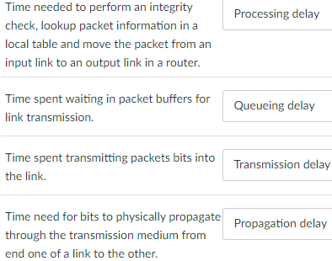
Question 1.4-01
1.4-01 Components of packet delay. Match the description of each component of packet delay to its name in the pull down list.

Slide 4

Chapter 1: roadmap
What is the Internet?
What is a protocol?
Network edge: hosts, access network, physical media
Network core: packet/circuit switching, internet structure
Performance: loss, delay, throughput
Security
Protocol layers, service models

Slide 5

How do packet delay and loss occur?
IMPORTANT
packets queue in router buffers, waiting for turn for transmission
queue length grows when arrival rate to link (temporarily) exceeds output link capacity
packet loss occurs when memory to hold queued packets fills up
packet being transmitted (transmission delay)
A
B
packets in buffers (queueing delay)
free (available) buffers: arriving packets
dropped (loss) if no free buffers

Slide 6
Packet delay: four sources
IMPORTANT
transmission
A
propagation
B
nodal
processing
queueing
d_{nodal} = d_{proc} + d_{queue} + d_{trans} + d_{prop}
d_{proc}: nodal processing
check bit errors
determine output link
typically < microsecs
d_{queue}: queueing delay
time waiting at output link for transmission
depends on congestion level of router

Slide 7
Packet delay: four sources
IMPORTANT
transmission
A
propagation
B
nodal
processing
queueing
d_{nodal} = d_{proc} + d_{queue} + d_{trans} + d_{prop}
d_{trans}: transmission delay:
L: packet length (bits)
R: link transmission rate (bps)
d_{trans} = L/R
d_{prop}: propagation delay:
d: length of physical link
s: propagation speed (~2x10⁸ m/sec)
d_{prop} = d/s
d_{trans} and d_{prop}
very different

Slide 8
Throughput
IMPORTANT
throughput: rate (bits/time unit) at which bits are being sent from sender to receiver
instantaneous: rate at given point in time
average: rate over longer period of time
link capacity
R_{s} bits/sec
link capacity
R_{c} bits/sec
pipe that can carry
fluid at rate
(R_{s} bits/sec)
pipe that can carry
fluid at rate
(R_{c} bits/sec)
server sends bits
(fluid) into pipe
server, with
file of F bits
to send to client

Slide 9
Throughput
IMPORTANT
R_{s} < R_{c} What is average end-end throughput?
R_{s} bits/sec
R_{c} bits/sec
R_{s} > R_{c} What is average end-end throughput?
R_{s} bits/sec
R_{c} bits/sec
bottleneck link
link on end-end path that constrains end-end throughput

Slide 10
Throughput: network scenario
IMPORTANT
per-connection end-end throughput: min(R_{c},R_{s},R/10)
in practice: R_{c} or R_{s} is often bottleneck
Link utilization: used bandwidth/available bandwidth. For the three links:
min(R_{c},R_{s},R/10)/R_{s}
min(R_{c},R_{s},R/10)/(R/10)
min(R_{c},R_{s},R/10)/R_{c}
R_{s}
R_{s}
R_{s}
R
R_{c}
R_{c}
R_{c}
10 connections (fairly) share backbone bottleneck link R bits/sec
* Check out the online interactive exercises for more examples: http://gaia.cs.umass.edu/kurose_ross/

Slide 11
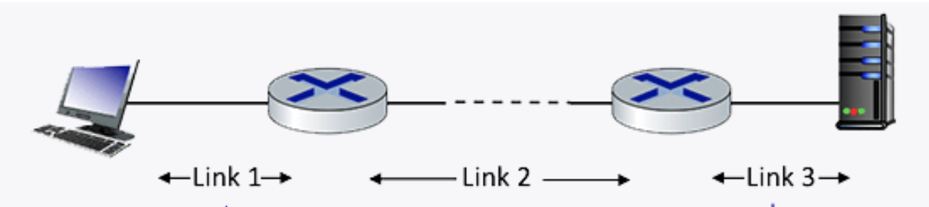
Question 1.4-01a
1.4-01a. Performance: Delay. Consider the network shown in the figure below, with three links, each with a transmission rate of 1 Mbps, and a propagation delay of 1 msec per link. Assume the length of a packet is 1000 bits.
What is the end-end delay of a packet from when it first begins transmission on link 1, until is it received in full by the server at the end of link 3. You can assume that queueing delays and packet processing delays are zero, but make sure you include packet transmission time delay on all links. Assume store-and forward packet transmission.
Each link has transmission delay 1000 bits/1 Mbps = 1ms. So each link has total delay of transmission + propagation = 1+1=2 ms.
For the three links, the total delay = 2 + 2 + 2 = 6 ms. `

Slide 12
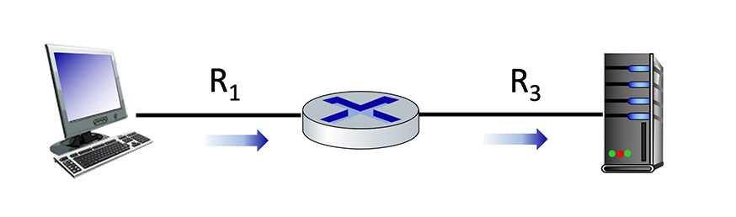
Question 1.4-01b
Maximum end-end throughput. Consider the scenario shown below, with a single source client sending to a server over two links of capacities R1=100 Mbps and R3=10 Mbps.
What is the maximum achievable end-end throughput (in Mbps, give an integer value) for the client-to-server pair, assuming that the client is trying to send at its maximum rate?
min (R1, R3) = min (100, 10) = 10 Mpbs.

Slide 13
Question 1.4-01c
Performance: Maximum end-end throughput. Consider the scenario shown below, with a single source client sending to a server over two links of capacities R1=10 Mbps and R3=100 Mbps.
What is the maximum achievable end-end throughput (in Mbps, give an integer value) for the client-to-server pair, assuming that the client is trying to send at its maximum rate?
min (R1, R3) = min (10, 100) = 10 Mpbs.

Slide 14
Question 1.4-01c
Performance: Maximum end-end throughput. Consider the scenario shown below, with a single source client sending to a server over two links of capacities R1=10 Mbps and R3=100 Mbps.
What is the maximum achievable end-end throughput (in Mbps, give an integer value) for the client-to-server pair, assuming that the client is trying to send at its maximum rate?
min (R1, R3) = min (10, 100) = 10 Mpbs.

Slide 15
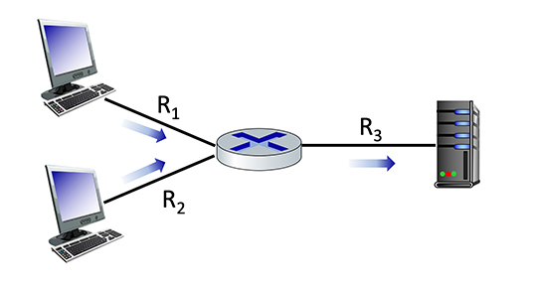
Question 1.4-01d
100 Mbps
10 Mbps
1.4-01e. Performance: Maximum end-end throughput. Consider the scenario shown below, with two clients sending to a server. The links attached to clients each have a capacity of R1= R2 = 100 Mbps. The link from the router to the server has a capacity of and R3 = 10 Mbps, which is shared evenly between the two sources when they are each sending at their maximum rate.
What is the maximum achievable end-end throughput (in Mbps, give an integer value) for each client-to-server pair, assuming that the client is trying to send at its maximum rate?
100 Mbps
The maximum achievable end-end throughput is min (R1, R3/2) = min (R2, R3/2) = min (100, 10/2) = 5 Mbps.
The shared 100 Mbps link is fairly shared among two end-to-end connections (R1, R3) and (R2, R3), hence each end-to-end connection gets 10/2=5 Mbps.
Notes:
The link bandwidth is independent of the transmission direction.

Slide 16
Question 1.4-01e
10 Mbps
100 Mbps
1.4-01e. Performance: Maximum end-end throughput. Consider the scenario shown below, with two clients sending to a server. The links attached to clients each have a capacity of R1= R2 = 10 Mbps. The link from the router to the server has a capacity of and R3 = 100 Mbps, which is shared evenly between the two sources when they are each sending at their maximum rate.
What is the maximum achievable end-end throughput (in Mbps, give an integer value) for each client-to-server pair, assuming that the client is trying to send at its maximum rate?
10 Mbps
The maximum achievable end-end throughput is min (R1, R3/2) = min (R2, R3/2) = min (10, 100/2) = 10 Mbps.
The shared 100 Mbps link is fairly shared among two end-to-end connections (R1, R3) and (R2, R3), hence each end-to-end connection gets 100/2=50 Mbps.
Note that min (R1, R2, R3/2) is incorrect, since R1 and R2 are on deferent end-to-end connections.
Remember that parallel links should never be put into the min() formula, only sequential links forming the same end-to-end connection should be in the same min() formula.
Notes:
The link bandwidth is independent of the transmission direction.

Slide 17
Question 1.4-01e variations
10 Mbps
100 Mbps
1.4-01e. Performance: Maximum end-end throughput. Consider the scenario shown below, with two clients sending to a server. The links attached to clients each have a capacity of R1 = 10 Mbps, R2 = 20 Mbps. The link from the router to the server has a capacity of and R3 = 100 Mbps, which is shared evenly between the two sources when they are each sending at their maximum rate.
What is the maximum achievable end-end throughput (in Mbps, give an integer value) for each client-to-server pair, assuming that the client is trying to send at its maximum rate?
20 Mbps
For client on top, the maximum achievable end-end throughput is min (R1, R3/2) = min (10, 100/2) = 10 Mbps.
For client on bottom, the maximum achievable end-end throughput is min (R1, R3/2) = min (20, 100/2) = 20 Mbps.
The shared 100 Mbps link is fairly shared among two end-to-end connections (R1, R3) and (R2, R3), hence each end-to-end connection gets 100/2=50 Mbps.
Notes:
The link bandwidth is independent of the transmission direction.

Slide 18
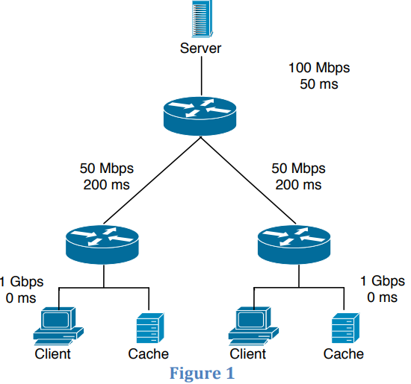
Question 1.4-02a
Consider the scenario shown in Figure 1 in which a server is connected to a router by a 100Mbps link with a 50ms propagation delay. Initially this router is also connected to two routers, each over a 50Mbps link with a 200ms propagation delay. A 1Gbps link connects a host and a cache (if present) to each of these routers and we assume that this link has 0 propagation delay. All packets in the network are 20,000 bits long.
What is the end-­to­‐end delay (in msec) from when a packet is transmitted by the server to when it is received by the client? In this case, we assume there are no caches, there’s no queuing delay at the routers, and the packet processing delays at routers and nodes are all 0.
ANS: If all packets are 20,000 bits long it takes 200 usec to send the packet over the 100Mbps link, 400 usec to send over the 50Mbps link, and 20 usec to send over the 1Gbps link.
Sum of the three-link transmission is 620 usec. Thus, the total end-to-end delay is 250 ms + 620 usec = 250.62 msec.

Slide 19
Question 1.4-02b
Here we assume that client hosts send requests for files directly to the server (caches are not used or off in this case). What is the maximum rate at which the server can deliver data to a single client if we assume no other clients are making requests?
Server can send at the max of the bottleneck link bandwidth min(100/2 Mbps, 50 Mbps, 1 Gbps) = 50 Mbps, since the top link is shared and the other two links are separate for each client and not shared.
Suppose we had 10 clients on the bottom, then the bottleneck link bandwidth min(100/10 Mbps, 50 Mbps, 1 Gbps) = 10 Mbps.

Slide 20
Question 1.4-02c
Again we assume only one active client but in this case the caches are on and behave like HTTP caches. A client’s HTTP GET is always first directed to its local cache. 60% of the requests can be satisfied by the local cache. What is the average rate at which the client can receive data in this case?
60% of the requests can be satisfied by the local cache, with bandwidth of 1 Gbps = 1000 Mpbs.
40% of the requests go to the remote server, with bandwidth of min (100 Mbps, 50 Mbps, 1Gbps) = 50 Mpbs.
Since we assume only one active client, we do not have 100/2 as the first term.
The average rate at which the client can receive data is .4*50+.6*1000=620 Mbps

Slide 21
Question 1.4-02d
Now clients in both LANs are active and the both caches are on. 60% of the requests can be satisfied by the local caches. What is the average rate at which each client can receive data?
60% of the requests can be satisfied by the local cache, with bandwidth of 1 Gbps = 1000 Mpbs.
40% of the requests go to the remote server, with bandwidth of min (100/2 Mbps, 50 Mbps, 1Gbps) = 50 Mpbs.
Since we both clients are active, we have 100/2 as the first term.
The average rate at which the client can receive data is .4*50+.6*1000=620 Mbps

Slide 22
Client/server socket interaction: TCP
IMPORTANT
server (running on hostid)
client
create socket,
port=x, for incoming request:
serverSocket = socket()
wait for incoming
connection request
TCP
connection setup
create socket,
connect to hostid, port=x
connectionSocket =
serverSocket.accept()
clientSocket = socket()
send request using
clientSocket
read request from
connectionSocket
write reply to
connectionSocket
read reply from
clientSocket
close
connectionSocket
close
clientSocket

Slide 23
Example app: TCP client
IMPORTANT
Python TCPClient
from socket import *
serverName = 'servername'
serverPort = 12000
clientSocket = socket(AF_INET, SOCK_STREAM)
clientSocket.connect((serverName,serverPort))
sentence = input('Input lowercase sentence:')
clientSocket.send(sentence.encode())
modifiedSentence = clientSocket.recv(1024)
print ('From Server:', modifiedSentence.decode())
clientSocket.close()
create TCP socket for server, remote port 12000
No need to attach server name, port
Note: this code update (2023) to Python 3

Slide 24
Example app: TCP server
IMPORTANT
Python TCPServer
from socket import *
serverPort = 12000
serverSocket = socket(AF_INET,SOCK_STREAM)
serverSocket.bind(('',serverPort))
serverSocket.listen(1)
print('The server is ready to receive')
while True:
connectionSocket, addr = serverSocket.accept()
sentence = connectionSocket.recv(1024).decode()
capitalizedSentence = sentence.upper()
connectionSocket.send(capitalizedSentence.
encode())
connectionSocket.close()
create TCP welcoming socket
server begins listening for incoming TCP requests
loop forever
server waits on accept() for incoming requests, new socket created on return
read bytes from socket (but not address as in UDP)
close connection to this client (but not welcoming socket)
Note: this code update (2023) to Python 3

Slide 25
Question 2.7-4
2.7-4 How many sockets? Suppose a Web server has five ongoing connections that use TCP receiver port 80, and assume there are no other TCP connections (open or being opened or closed) at that server. How many TCP sockets are in use at this server?
ANS: 6.
1 serverSocket and 5 connectionSockets

Slide 26
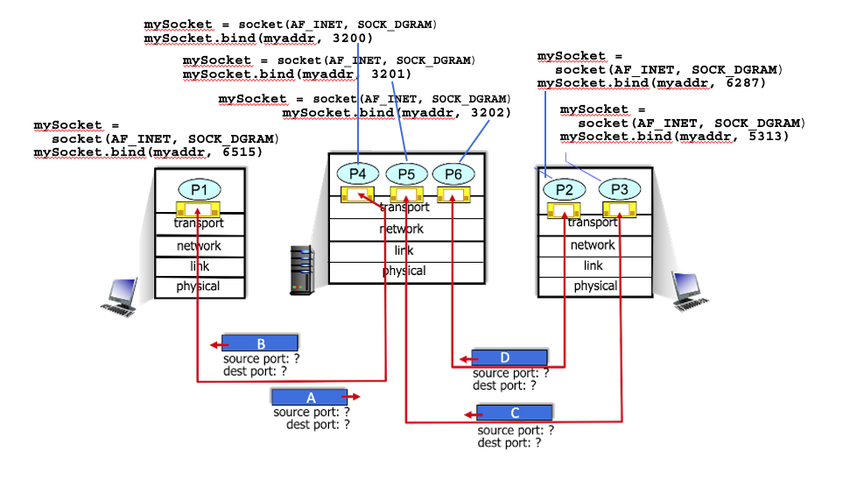
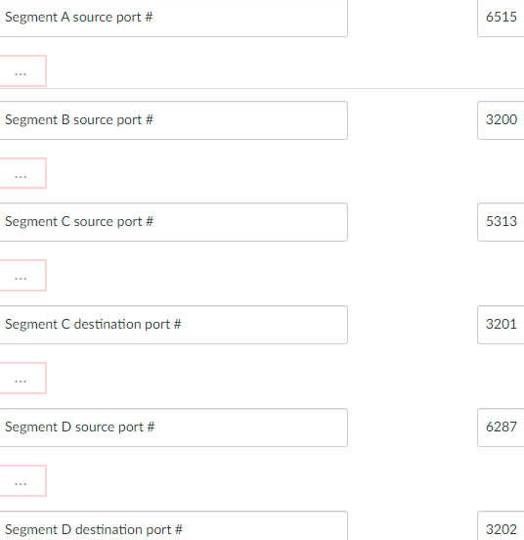
Question 3.2-01
3.2-01. UDP multiplexing and demultiplexing. Consider the figure below, with 6 sockets shown across the network, and the corresponding Python code at each host. There are four UDP segments in flight. Match the source and destination port numbers for each segment with a value below.

Slide 27
Question 3.2-04
3.2-04. TCP demultiplexing. Which of the following datagram and segment header fields are used, when demultiplexing data up to a TCP socket?
ANS: Source and destination IP addresses, and source and destination port numbers.

Slide 28
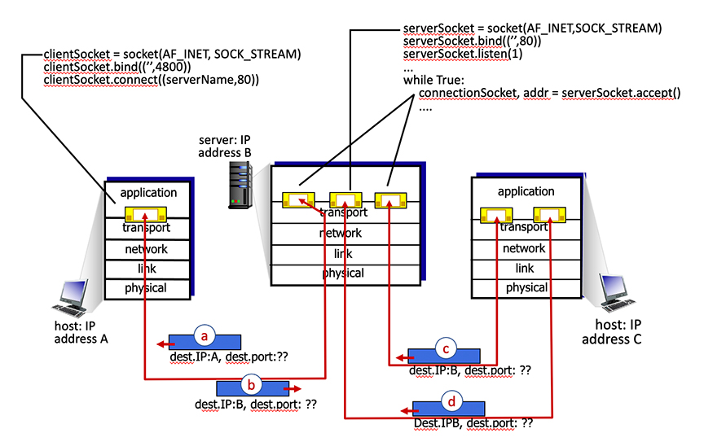
Question 3.2-05
3.2-05a. TCP multiplexing/demultiplexing and connection management. Consider the scenario in the figure below, with two client hosts – client A (with one TCP socket) and client B (with two TCP sockets) exchanging packets with server B (with three TCP sockets). The Python code that created the three sockets on the server and the TCP code that created the one socket at the left client is shown in the diagram, with lines indicating the line of executed Python code that created each of the sockets. Which of the packets a, b, c, d have destination port 80?
ANS: Packets b, c and d
Notes:
https://www.perplexity.ai/search/connection-oriented-demultiple-DayrDmqiStCQCLRRjqS30w

Slide 29
Internet checksum
IMPORTANT
Goal: detect errors (i.e., flipped bits) in transmitted segment
sender:
treat contents of UDP segment (including UDP header fields and IP addresses) as sequence of 16-bit integers
checksum: addition of segment content, then flip all the bits (one’s complement sum)
checksum value put into UDP checksum field
receiver:
compute checksum of received segment
check if computed checksum equals checksum field value:
not equal - error detected
equal - no error detected. But maybe errors nonetheless? More later ….

Slide 30
Internet checksum: an example
IMPORTANT
example: add two 16-bit integers
1 1 1 0 0 1 1 0 0 1 1 0 0 1 1 0
1 1 0 1 0 1 0 1 0 1 0 1 0 1 0 1
wraparound
1 1 0 1 1 1 0 1 1 1 0 1 1 1 0 1 1
sum
1 0 1 1 1 0 1 1 1 0 1 1 1 1 0 0
checksum
0 1 0 0 0 1 0 0 0 1 0 0 0 0 1 1
Note: when adding numbers, a carryout from the most significant bit needs to be added to the result
* Check out the online interactive exercises for more examples: http://gaia.cs.umass.edu/kurose_ross/interactive/

Slide 31
Internet checksum: weak protection!
IMPORTANT
example: add two 16-bit integers
0 1
1 1 1 0 0 1 1 0 0 1 1 0 0 1 1 0
1 0
1 1 0 1 0 1 0 1 0 1 0 1 0 1 0 1
wraparound
1 1 0 1 1 1 0 1 1 1 0 1 1 1 0 1 1
Even though numbers have changed (bit flips), no change in checksum!
sum
1 0 1 1 1 0 1 1 1 0 1 1 1 1 0 0
checksum
0 1 0 0 0 1 0 0 0 1 0 0 0 0 1 1

Slide 32
Question 3.3-1
3.3-1. Internet Checksum. Consider the two sixteen bit numbers: 10110100 01000110 01001000 01101111 Compute the Internet Checksum of these two values Enter the 2 bytes each as an 8-bit number with only 0’s and 1’s, and make a single blank space between the two 8-bit numbers (e.g., 01010101 00101000).
ANS: adding up the two numbers we have: 11111100 10110101
Taking ones complement we have: 00000011 01001010

Slide 33
Router architecture overview
IMPORTANT
high-level view of generic router architecture:
routing, management
control plane (software)
operates in millisecond
time frame
routing
processor
forwarding data plane (hardware) operates in nanosecond timeframe
high-speed
switching
fabric
router input ports
router output ports

Slide 34
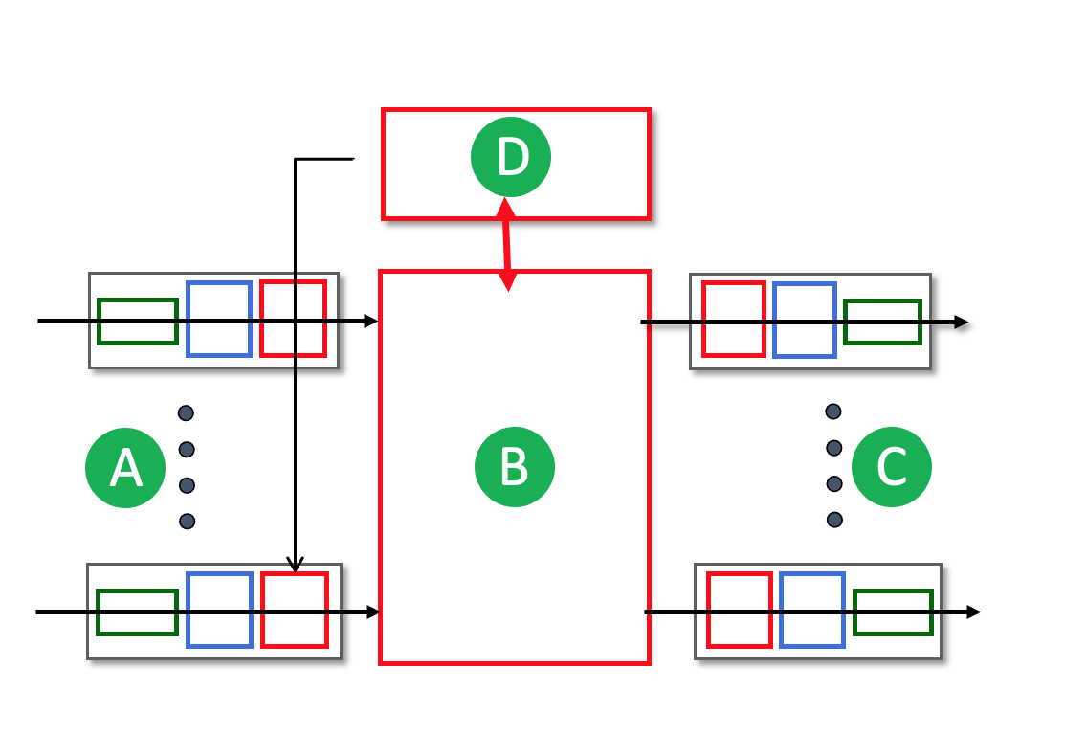
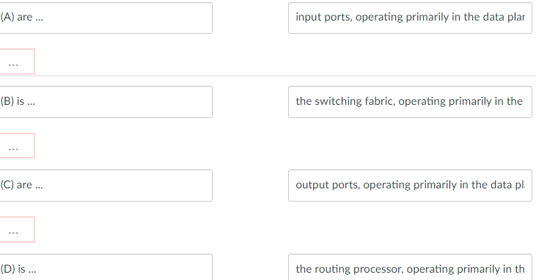
Question 4.2-1
4.2-1. What's inside a router? Match the names of the principal router components (A,B,C,D below) with their function and whether they are in the network-layer data plane or control plane.

Slide 35


Input port functions
IMPORTANT
lookup,
forwarding
queueing
line
termination
link
layer
protocol
(receive)
switch
fabric
physical layer:
bit-level reception
Datagram
decentralized switching:
using header field values, lookup output port using forwarding table in input port memory (“match plus action”)
goal: complete input port processing at ‘line speed’
input port queuing: if datagrams arrive faster than forwarding rate into switch fabric
link layer:
e.g., Ethernet
(chapter 6)
Frame
Notes:
Green box is a physical layer responsible for receiving bit level transmission. Copper, fiber wireless.
Link layer in blue – bit assemble into Ethernet frame. We will discuss this in details in chapter 6.
But most critical one, is here. Lookup, forwarding function. Lookup and forward is “Match plus action” behavior.
GOAL – processing at “line speed”, otherwise, buffer will be full and packet will be lost

Slide 36
Input port functions
IMPORTANT
lookup,
forwarding
queueing
line
termination
link
layer
protocol
(receive)
switch
fabric
physical layer:
bit-level reception
decentralized switching:
using header field values, lookup output port using forwarding table in input port memory (“match plus action”)
destination-based forwarding: forward based only on destination IP address (traditional)
generalized forwarding: forward based on any set of header field values
link layer:
e.g., Ethernet
(chapter 6)

Slide 37
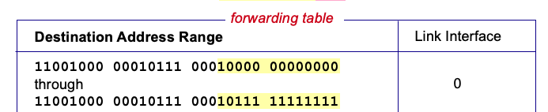

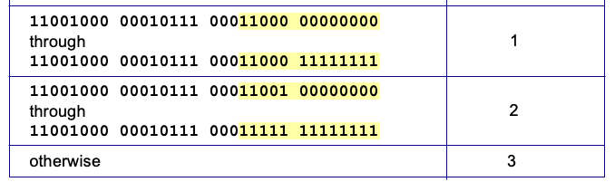
Destination-based forwarding
IMPORTANT
3
Q: but what happens if ranges don’t divide up so nicely?
Notes:
Text for this animation:
This all works out pretty nice and looks pretty simple!
But of course the devil is in the details, as the saying goes.
What happens, for example, when a subset of addresses say in this first range should go to say interface 3, rather than interface 0. Well, of course we could split the first address range into multiple pieces, and add in this new subrange with its new destination output port. But it turns out there’s a much simpler and elegant way to do this. Known as longest prefix matching.

Slide 38
Question 4.2-2
4.2-2. Where does destination address lookup happen? Where in a router is the destination IP address looked up in a forwarding table to determine the appropriate output port to which the datagram should be directed?
(Correct) At the input port where a packet arrives.
At the output port leading to the next hop towards the destination.
Within the switching fabric.
Within the routing processor

Slide 39
Question 4.2-3
4.2-3. Where does "match+action" happen? Where in a router does "match plus action" happen to determine the appropriate output port to which the arriving datagram should be directed?
(Correct) At the input port where a packet arrives.
At the output port leading to the next hop towards the destination.
Within the switching fabric.
Within the routing processor.

Slide 40
Network layer: “data plane” roadmap
Network layer: overview
data plane
control plane
What’s inside a router
input ports, switching, output ports
buffer management, scheduling
IP: the Internet Protocol
datagram format
addressing
network address translation
IPv6
Generalized Forwarding, SDN
Match+action
OpenFlow: match+action in action
Middleboxes

Slide 41
Packet Scheduling: FCFS
IMPORTANT
packet scheduling: deciding which packet to send next on link
first come, first served
priority
round robin
weighted fair queueing
FCFS: packets transmitted in order of arrival to output port
also known as: First-in-first-out (FIFO)
real world examples?
Abstraction: queue
R
packet
departures
packet
arrivals
queue
(waiting area)
link
(server)

Slide 42
Scheduling policies: priority
IMPORTANT
Priority scheduling:
arriving traffic classified, queued by class
any header fields can be used for classification
high priority queue
arrivals
classify
link
departures
low priority queue
2
send packet from highest priority queue that has buffered packets
FCFS within priority class
1
3
4
5
arrivals
packet in service
1
3
2
4
5
departures
1
3
2
4
5

Slide 43
Scheduling policies: round robin
IMPORTANT
Round Robin (RR) scheduling:
arriving traffic classified, queued by class
any header fields can be used for classification
server cyclically, repeatedly scans class queues, sending one complete packet from each class (if available) in turn
R
classify
arrivals
link
departures

Slide 44
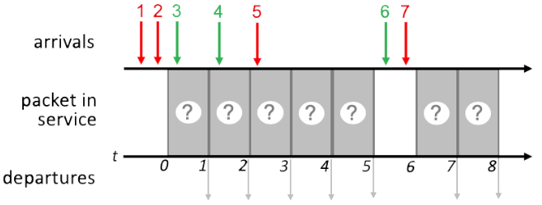
Question 4.2-7
Packet scheduling. Consider the pattern of red and green packet arrivals to a router’s output port queue, shown below. Suppose each packet takes one time slot to be transmitted, and can only begin transmission at the beginning of a time slot after its arrival. Indicate the sequence of departing packet numbers (at t = 1, 2, 3, 4, 5, 7, 8) under FCFS, priority, round-robin scheduling.

Slide 45
Question 4.2-7a FCFS Scheduling
Transmit order the same as packet arrival order of 1 2 3 4 5 6 7
1
2
3
4
5
6
7
1
2
3
4
5
6
7
1 2 3 4 5 6 7

Slide 46
Question 4.2-7b Priority Scheduling
Time 0: 1, 2 in queue, transmit 1
FCFS within same priority
Time 1: 2, 3 in queue, transmit 2
Time 2: 3, 4 in queue, transmit 3
FCFS within same priority
Time 3: 4, 5 in queue, transmit 5
Time 4: 4 in queue, transmit 4
Time 6: 6, 7 in queue, transmit 7
Time 7: 6 in queue, transmit 6
1
2
3
5
4
7
6
1
2
3
5
4
7
6
1 2 3 5 4 7 6
Network Layer: 4-46

Slide 47
Question 4.2-7c Round Robin Scheduling
Assume a round-robin scheduling cycle begins with red packets. i.e., (red, green) in each round.
Time 0: 1, 2 in queue, transmit 1
1st round of (red, green)
Time 1: 2, 3 in queue, transmit 3
1st round of (red, green)
Time 2: 2. 4 in queue, transmit 2
2nd round of (red, green)
Time 3: 4, 5 in queue, transmit 4
2nd round of (red, green)
Time 4: 5 in queue, transmit 5
3RD round of (red, green). Since there is no green packet ready, this round is (red, null)
Time 6: 6, 7 in queue, transmit 7
4th round of (red, green)
Time 7: 6 in queue, transmit 6
4th round of (red, green)
Summary:
Times 0-1: 1st round: (1, 3)
Times 2-3: 2nd round: (2, 4)
Time 4: 3rd round: (5, null)
No green packets ready
Times 6-7: 4th round: (7, 6)
1
3
2
4
5
7
6
1
3
2
4
5
7
6
1 3 2 4 5 7 6

Slide 48
Network layer: “data plane” roadmap
Network layer: overview
data plane
control plane
What’s inside a router
input ports, switching, output ports
buffer management, scheduling
IP: the Internet Protocol
datagram format
addressing
network address translation
IPv6
Generalized Forwarding, SDN
match+action
OpenFlow: match+action in action
Middleboxes

Slide 49
Subnets
IMPORTANT
223.1.1.1
What’s a subnet ?
device interfaces that can physically reach each other without passing through an intervening router
223.1.2.1
223.1.1.2
223.1.1.4
223.1.2.9
223.1.1.3
223.1.3.27
223.1.2.2
IP addresses have structure:
subnet part: devices in same subnet have common high order bits
host part: remaining low order bits
223.1.3.1
223.1.3.2
network consisting of 3 subnets

Slide 50
Subnets
IMPORTANT
subnet 223.1.1.0/24
223.1.1.1
subnet 223.1.2.0/24
Recipe for defining subnets:
detach each interface from its host or router, creating “islands” of isolated networks
each isolated network is called a subnet
223.1.2.1
223.1.1.2
223.1.1.4
223.1.2.9
223.1.1.3
223.1.3.27
223.1.2.2
subnet
223.1.3.0/24
223.1.3.1
223.1.3.2
subnet mask: /24
(high-order 24 bits: subnet part of IP address)

Slide 51
Subnets
IMPORTANT
223.1.1.2
subnet 223.1.1/24
where are the subnets?
what are the /24 subnet addresses?
223.1.1.1
223.1.1.4
223.1.1.3
223.1.9.2
223.1.7.0
subnet 223.1.7/24
subnet 223.1.9/24
223.1.9.1
223.1.7.1
223.1.8.1
223.1.8.0
subnet 223.1.2/24
223.1.2.6
subnet 223.1.8/24
223.1.3.27
subnet 223.1.3/24
223.1.2.1
223.1.2.2
223.1.3.1
223.1.3.2

Slide 52
IP addressing: CIDR
IMPORTANT
CIDR: Classless InterDomain Routing (pronounced “cider”)
subnet portion of address of arbitrary length
address format: a.b.c.d/x, where x is # bits in subnet portion of address
subnet
part
host
part
11001000 00010111 00010000 00000000
200.23.16.0/23

Slide 53
Question 4.3-04
4.3-04. What is a subnet? What is meant by an IP subnet? (Check zero, one or more of the following characteristics of an IP subnet).
A A set of device interfaces that can physically reach each other without passing through an intervening router.
Correct
B A set of devices that always have a common first 16 bits in their IP address.
Incorrect as the subnet mask may not be 16 bits
C A set of devices that have a common set of leading high order bits in their IP address.
Correct
D A set of devices all manufactured by the same equipment maker/vendor.
Incorrect

Slide 54
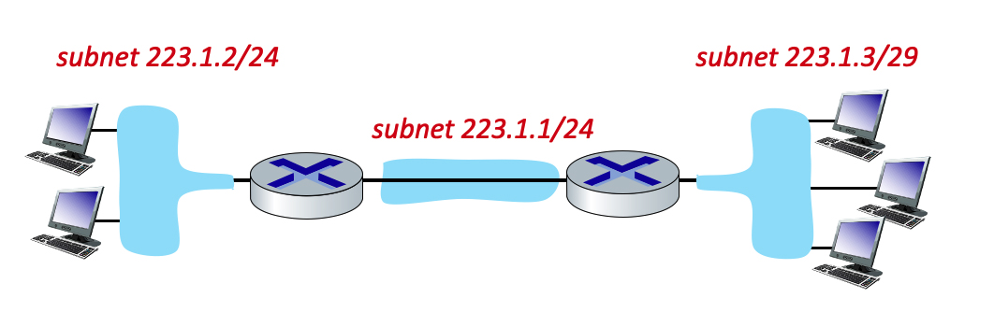
Question 4.3-05ab
4.3-05. Subnetting(a). Consider the three subnets in the diagram below.
1. What is the maximum # of interfaces in the 223.1.2/24 network?
2. What is the maximum # of interfaces in the 223.1.3/29 network?
Including the network address (all host bits in the IP address equal to 0) and broadcast address (all host bits in the IP address equal to 1).
1 ANS: In 223.1.2/24
Network, since 32-24
=8 bits for host address,
Hence maximum # of
Interfaces = 2⁸=256
2 ANS: In 223.1.3/29
Network, since 32-29
=3 bits for host address,
Hence maximum # of
Interfaces = 2³=8
subnet
part
host
part
24 bits
8 bits
29 bits
3 bits

Slide 55
Question 4.3-05c
4.3-05. Subnetting(a). Consider the three subnets in the diagram below.
3. Which of the following addresses can not be used by an interface in the 223.1.3/29 network? Check all that apply.
223.1.3.6, 223.1.3.2, 223.1.3.16, 223.1.2.6, 223.1.3.28
3 ANS: In 223.1.3/29
Network, since 32-29
=3 bits for host address,
Hence maximum # of
Interfaces = 2³=8, ranging
From 0 to 7. Hence
223.1.3.6, 223.1.3.2 are OK
223.1.3.16, 223.1.3.28 are not OK
since the host ID exceeds 7
223.1.2.6 is not OK since network address
223.1.2 does not match 223.1.3
subnet
part
host
part
24 bits
8 bits
29 bits
3 bits

Slide 56
Network layer: “data plane” roadmap
Network layer: overview
data plane
control plane
What’s inside a router
input ports, switching, output ports
buffer management, scheduling
IP: the Internet Protocol
datagram format
addressing
network address translation
IPv6
Generalized Forwarding, SDN
match+action
OpenFlow: match+action in action
Middleboxes

Slide 57
IP addresses: how to get one?
IMPORTANT
That’s actually two questions:
Q: How does a host get IP address within its network (host part of address)?
Q: How does a network get IP address for itself (network part of address)
How does host get IP address?
hard-coded by sysadmin in config file (e.g., /etc/rc.config in UNIX)
DHCP: Dynamic Host Configuration Protocol: dynamically get address from as server
“plug-and-play”

Slide 58
DHCP: Dynamic Host Configuration Protocol
IMPORTANT
goal: host dynamically obtains IP address from network server when it “joins” network
can renew its lease on address in use
allows reuse of addresses (only hold address while connected/on)
support for mobile users who join/leave network
DHCP overview:
host broadcasts DHCP discover msg [optional]
DHCP server responds with DHCP offer msg [optional]
host requests IP address: DHCP request msg
DHCP server sends address: DHCP ack msg

Slide 59
Question 4.3-06
4.3-06. Plug-and-play. What is meant by saying that DHCP is a "plug and play" protocol?
The host needs to “plug” (by wire or wirelessly) into the local network in order to access (“play” in) the Internet
No manual configuration is needed for the host to join the network., (Correct answer)
The network provides an Ethernet jack for a host’s Ethernet adapter., (Incorrect answer)

Slide 60
IPv6: motivation
IMPORTANT
initial motivation: 32-bit IPv4 address space would be completely allocated
additional motivation:
speed processing/forwarding: 40-byte fixed length header
enable different network-layer treatment of “flows”

Slide 61
IP Datagram format
32 bits
IP protocol version number
head.
len
type of
service
total datagram
length (bytes)
ver
length
header length(bytes)
“type” of service:
diffserv (0:5)
ECN (6:7)
flgs
fragment
offset
fragmentation/
reassembly
16-bit identifier
time to
live
upper
layer
header
checksum
header checksum
TTL: remaining max hops
(decremented at each router)
source IP address
32-bit source IP address
destination IP address
Maximum length: 64K bytes
Typically: 1500 bytes or less
upper layer protocol (e.g., TCP or UDP)
32-bit destination IP address
overhead
options (if any)
e.g., timestamp, record route taken
20 bytes of TCP
20 bytes of IP
= 40 bytes + app layer overhead for TCP+IP
payload data
(variable length,
typically a TCP
or UDP segment)

Slide 62
IPv6 datagram format
IMPORTANT
flow label: identify datagrams in same "flow.” (concept of “flow” not well defined).
32 bits
priority: identify priority among datagrams in flow
ver
pri
flow label
payload len
next hdr
hop limit
source address
(128 bits)
128-bit
IPv6 addresses
destination address
(128 bits)
payload (data)
What’s missing (compared with IPv4):
no checksum (to speed processing at routers)
no fragmentation/reassembly
no options (available as upper-layer, next-header protocol at router)

Slide 63
Question 4.3-08
4.3-08. IPv4 versus IPv6. Which of the following fields occur ONLY in the IPv6 datagram header (i.e., appear in the IPv6 header but not in the IPv4 header)? Check all that apply.
Correct: 128-bit source and destination IP addresses.
The IP version number field.
The time-to-live (or hop limit) field.
The header checksum field.
Correct: The flow label field.
The header length field.
The options field.
The upper layer protocol (or next header) field.

Slide 64
NAT: network address translation
IMPORTANT
NAT translation table
WAN side addr LAN side addr
2: NAT router changes datagram source address from 10.0.0.1, 3345 to 138.76.29.7, 5001,
updates table
1: host 10.0.0.1 sends datagram to 128.119.40.186, 80
138.76.29.7, 5001 10.0.0.1, 3345
…… ……
S: 10.0.0.1, 3345
D: 128.119.40.186, 80
10.0.0.1
1
2
S: 138.76.29.7, 5001
D: 128.119.40.186, 80
10.0.0.4
10.0.0.2
138.76.29.7
S: 128.119.40.186, 80
D: 10.0.0.1, 3345
4
S: 128.119.40.186, 80
D: 138.76.29.7, 5001
3
10.0.0.3
3: reply arrives, destination address: 138.76.29.7, 5001

Slide 65
Question 4.3.10
4.3.10. Network Address Translation (NAT). Which one of the following operations is not performed by NAT.?
A Generating ACKs back to the TCP sender and then taking responsibility for reliably delivery the segment to its destination, possibly using a non-TCP reliable data transfer protocol.
B On an outgoing datagram, changing the transport-layer port number of the transport-layer segment inside a datagram received from the LAN side of the NAT.
C On an incoming datagram from the public Internet side of a NAT, changing the destination IP address of a datagram to a new destination IP address that is looked up in the NAT table, and (possibly after other actions), sending that IP datagram on to the LAN side of the NAT.
D On an outgoing datagram, changing the source IP address of a datagram received from the LAN side of the NAT
ANS: A
Notes:
Generating ACKs back to the TCP sender and then taking responsibility for reliably delivery the segment to its destination, possibly using a non-TCP reliable data transfer protocol.
On an outgoing datagram, changing the transport-layer port number of the transport-layer segment inside a datagram received from the LAN side of the NAT.
On an incoming datagram from the public Internet side of a NAT, changing the destination IP address of a datagram to a new destination IP address that is looked up in the NAT table, and (possibly after other actions), sending that IP datagram on to the LAN side of the NAT.
On an outgoing datagram, changing the source IP address of a datagram received from the LAN side of the NAT

Slide 66
OpenFlow abstraction
IMPORTANT
match+action: abstraction unifies different kinds of devices
Router
match: longest destination IP prefix
action: forward out a link
Switch
match: destination MAC address
action: forward or flood
Firewall
match: IP addresses and TCP/UDP port numbers
action: permit or deny
NAT
match: IP address and port
action: rewrite address and port

Slide 67
Generalized forwarding: summary
IMPORTANT
“match plus action” abstraction: match bits in arriving packet header(s) in any layers, take action
matching over many fields (link-, network-, transport-layer)
local actions: drop, forward, modify, or send matched packet to controller
“program” network-wide behaviors
simple form of “network programmability”
programmable, per-packet “processing”
historical roots: active networking
today: more generalized programming:
P4 (see p4.org).

Slide 68
Question 4.4-2
4.4-2. Generalized match+action. Which of the following match+actions can be taken in the generalized OpenFlow 1.0 match+action paradigm that we studied in Section 4.4? Check all that apply.
(Correct)... after matching on the destination IP address in the datagram header, the action taken is to forward the datagram to the output port associated with that destination IP address.
(Correct)... after matching on the destination IP address in the datagram header, the action taken is to decide whether or not to drop that datagram.
(Correct)... after matching on the port number in the segment's header, the action taken is to decide whether or not to drop that datagram containing that segment.
(Correct)... after matching on the port number in the segment's header, the action taken is to forward the datagram to the output port associated with that destination IP address.
(Correct)... after matching on the 48-bit link-layer destination MAC address, the action taken is to forward the datagram to the output port associated with that link-layer address.
(InCorrect)... after matching on the URL contained in an HTTP GET request in the TCP segment within the IP datagram, the action taken is to determine the IP address of the server associated with that URL, and to forward the datagram to the output port associated with that destination IP address.
At the IP layer, cannot see any application layer information such as the URL contained in an HTTP GET request
(Correct)... after matching on the source and destination IP address in the datagram header, the action taken is to forward the datagram to the output port associated with that source and destination IP address pair.

Slide 69
Flow table abstraction
IMPORTANT
flow: defined by header fields
generalized forwarding: simple packet-handling rules
match: pattern values in packet header fields
actions: for matched packet: drop, forward, modify, matched packet or send matched packet to controller
priority: disambiguate overlapping patterns
counters: #bytes and #packets
src = *.*.*.*, dest=3.4.*.* forward(2)
Flow table
match
action
src=1.2.*.*, dest=*.*.*.* drop
src=10.1.2.3, dest=*.*.*.* send to controller
* : wildcard
1
4
3
2

Slide 70
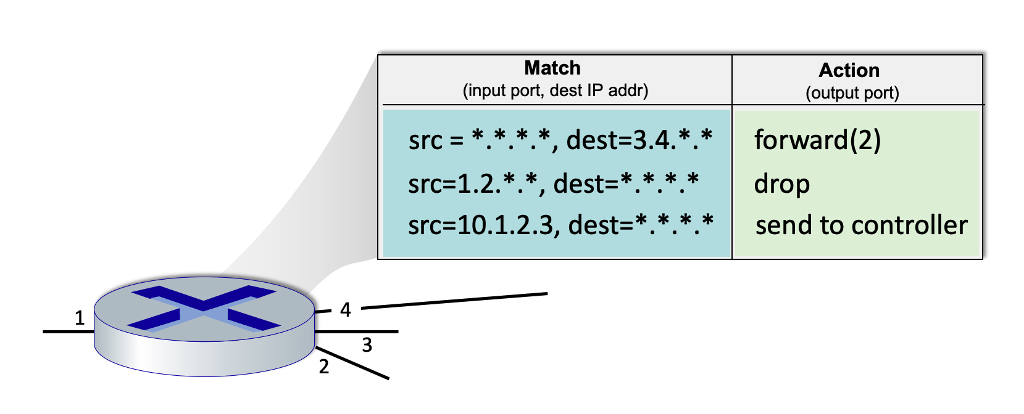
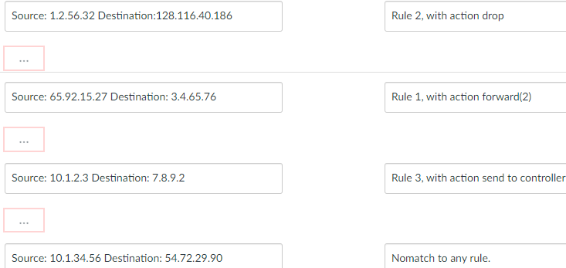
Question 4.4-4
4.4-4. Match+action in Openflow 1.0. Consider the figure below that shows the generalized forwarding table in a router. Recall that a * represents a wildcard value. Now consider an arriving datagram with the IP source and destination address fields indicated below. For each source/destination IP address pair, indicate which rule is matched. Note: assume that a rule that is earlier in the table takes priority over a rule that is later in the table and that a datagram that matches none of the table entries is dropped.

Slide 71
Network layer: “data plane” roadmap
Network layer: overview
What’s inside a router
IP: the Internet Protocol
Generalized Forwarding
Middleboxes
middlebox functions
evolution, architectural principles of the Internet

Slide 72
The IP hourglass
IMPORTANT
HTTP
SMTP
RTP
…
Internet’s “thin waist”:
one network layer protocol: IP
must be implemented by every (billions) of Internet-connected devices
QUIC
DASH
many protocols in physical, link, transport, and application layers
TCP
UDP
IP
Ethernet
…
PPP
PDCP
WiFi
Bluetooth
copper radio fiber

Slide 73
The IP hourglass, at middle age
IMPORTANT
HTTP
SMTP
RTP
…
QUIC
DASH
Internet’s middle age “love handles”?
middleboxes, operating inside the network
TCP
UDP
caching
NAT
IP
NFV
Firewalls
Ethernet
…
PPP
PDCP
WiFi
Bluetooth
copper radio fiber

Slide 74
Question 4.5-2
4.5-2. The "thin waist" of the Internet. What protocol (or protocols) constitutes the "thin waist" of the Internet protocol stack?
ANS: IP

